Slide 1
Predicting Customer Churn for a Subscription-Based Business
DATE: 12.06.2024
Use Case Description: The goal is to predict whether a customer will churn (i.e., cancel their subscription) based on historical behavioural data and demographic information. Reducing churn is critical for maintaining revenue and planning customer retention strategies.
Created by: Robby Pombo

Slide 2
Objectives
Data Background
Data Exploration & Cleaning
Feature Engineering
Predictive Modelling
Interpretation of Results
Actionable Recommendations

Slide 3
Data Background
Column Name | Description
customer_id | Unique identifier for each customer.
gender | Gender of the customer (Male/Female).
age | Age of the customer.
country | Country of the customer.
tenure_months | Number of months the customer has been subscribed.
monthly_charges | Monthly subscription charges in USD.
total_charges | Total amount charged to the customer.
Column Name | Description
contract_type | Type of subscription contract (Month-to-month, One year, Two year).
payment_method | Customer's payment method (Credit Card, PayPal, etc.).
has_internet_service | Whether the customer has an internet service add-on (Yes/No).
number_of_logins | Number of times the customer logged into the platform in the last 30 days.
watch_hours | Total hours the customer spent watching content on the platform in the last month.
churn | Target variable: whether the customer churned (Yes/No).

Slide 4
Data Exploration
Missing Data: Only the total_charges column has missing values (50 entries) which is 0.05% o
Numerical Summary:
Age: Ranges from 18 to 69 years, with an average of 43.8.
Tenure (months): Ranges from 1 to 59, with a median of 31.
Monthly Charges: Range from $20.04 to $119.97, averaging around $71.83.
Total Charges: Substantial variation, ranging from $100.91 to $4988.35, with some missing data.
Number of Logins: Varies widely, from 0 to 49 in the last 30 days.
Watch Hours: Ranges from near zero to a maximum of 99.89, with an average of 47.69 hours.
Data Type:
All columns have correct data type

Slide 5
Data Cleaning
Plan for Missing Values:
For total_charges, possible approaches include:
Imputing with the mean or median.
Imputing based on related features, such as contract_type and monthly_charges.
Drop the missing data.
Chosen approach:
Dropping the missing values is a reasonable choice since they make up only 5% of the dataset, which is relatively small and unlikely to significantly affect the analysis.
These missing values could be due to Data Entry Errors, Payment Issues, System Limitations, and Data Extraction Issues.

Slide 6
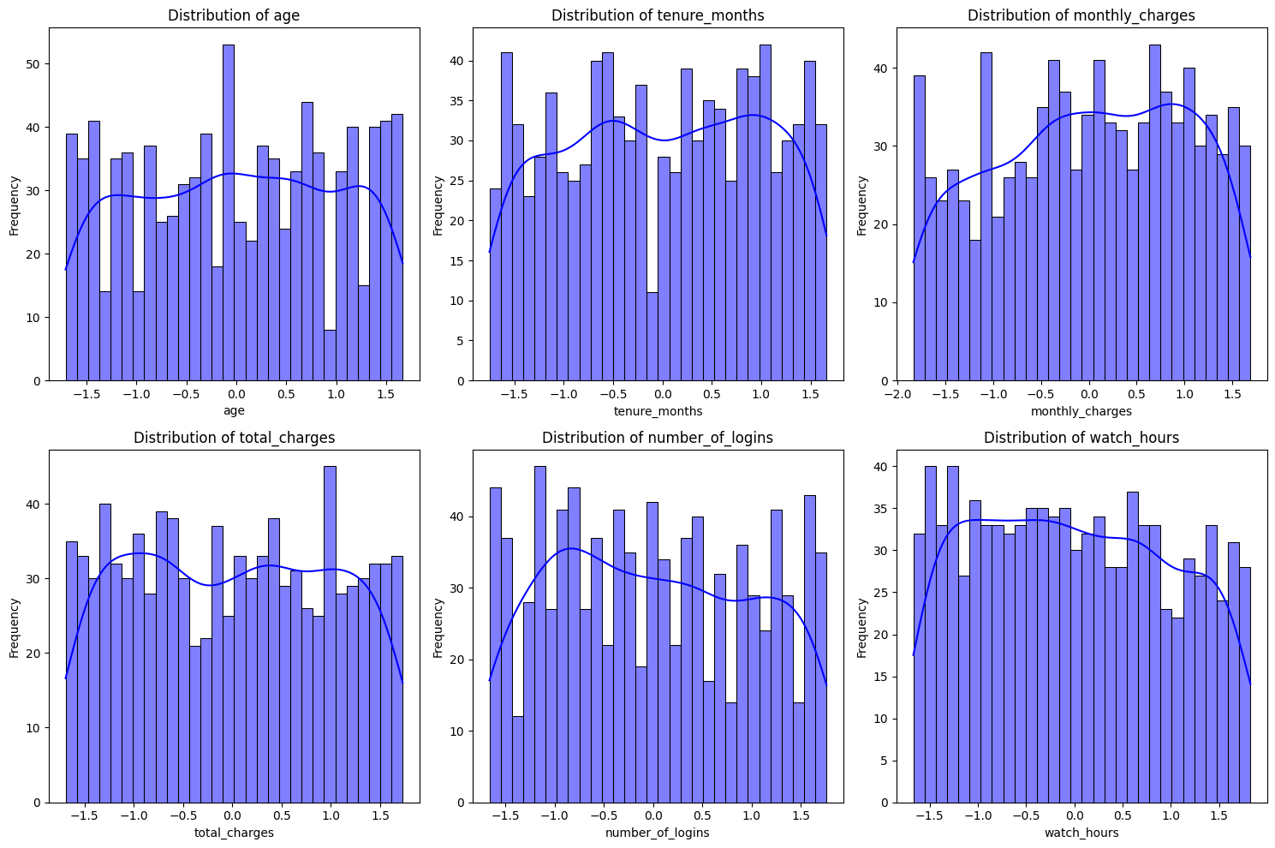
Exploratory Data Analysis
Numerical Columns
Age: The distribution is likely uniform or slightly skewed. Older or younger customers may have different churn behaviors, so stratifying churn by age could reveal trends.
Tenure (Months): Peaks at shorter tenures might indicate high churn among new customers. Long-tenure customers might show lower churn rates, reflecting loyalty.
Monthly Charges: A normally distributed pattern likely exists, with possible churn concentration among customers with higher or lower charges.
Total Charges: Likely shows a positive skew since it's cumulative. Long-tenure customers with consistent payments might have higher total_charges.
Number of Logins: The frequency distribution might reveal churned users logging in less frequently than retained users.
Watch Hours: A potential right skew suggests that customers who churn may engage less with the platform (e.g., low watch hours).

Slide 7
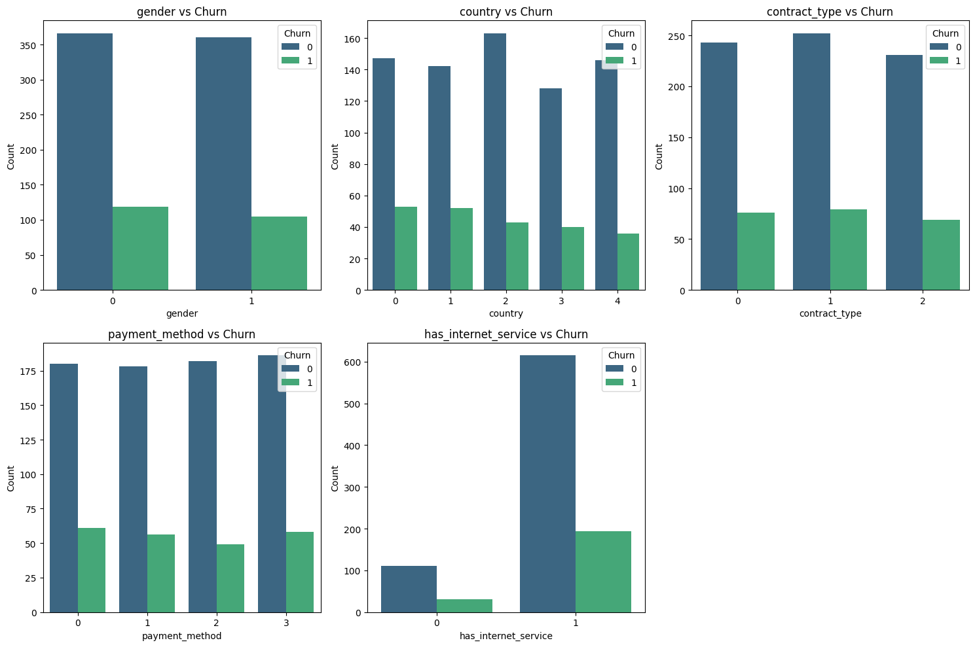
Exploratory Data Analysis
Categorical Columns
Gender: If the churn proportions are balanced across genders, this may indicate gender is not a significant predictor.
Country: Country-specific differences might emerge, suggesting localized factors influencing churn (e.g., market conditions, competition, cultural differences).
Contract Type: Month-to-month contracts likely have higher churn rates compared to one- or two-year contracts, given their flexibility.
Payment Method: Certain payment methods might correlate with higher churn rates, potentially reflecting customer preferences or ease of cancelation.
Internet Service: Customers without internet service might churn at higher rates, possibly indicating dissatisfaction or low engagement.

Slide 8
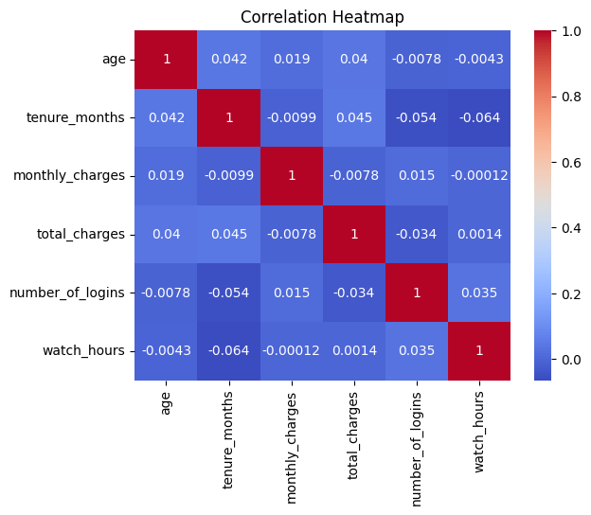
Exploratory Data Analysis
Correlation Heatmap
Weak correlations:
monthly_charges and watch_hours have a negligible correlation.
Slight positive correlations:
age and tenure_months show a mild positive correlation (0.042).
tenure_months and total_charges have a slightly stronger positive correlation (0.045)
Slight negative correlations:
tenure_months and number_of_logins have a weak negative correlation (-0.054).
tenure_months and watch_hours also show a mild negative correlation (-0.064).

Slide 9
Feature Engineering
1. Encoding Categorical Variables:
Label Encoding:
This converts categorical variables (like gender, country, contract type, etc.) into numerical values.
The LabelEncoder() assigns an integer label (e.g., 0, 1, 2) to each unique category in a column.
2. Scaling Numerical Features:
Standard Scaling:
StandardScaler() scales the numerical features to have a mean of 0 and a standard deviation of 1.
This helps in normalizing the range of the features, especially when they have different units or scales (e.g., age vs. monthly charges).

Slide 10
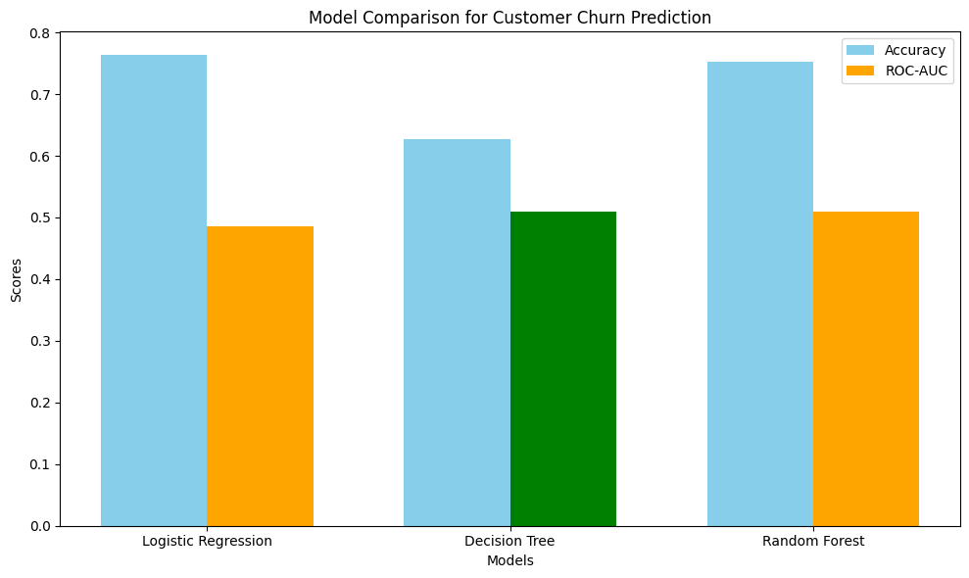
Predictive Modelling
Random Forest emerges as the best model for this customer churn prediction task, as it combines strong classification accuracy with the highest ROC-AUC score, which is crucial for understanding model performance when dealing with imbalanced classes.
Decision Tree might be useful in situations requiring faster, more interpretable models, but it still falls short in accuracy.
Logistic Regression is less effective than the other two models in this context, especially in terms of distinguishing churn vs. non-churn.
Winning Model:
Random Forest (86% accuracy)

Slide 11
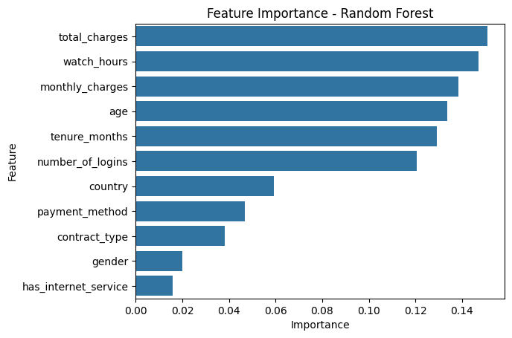
Feature Importance
Highly Important Features: The top features in the plot (with the longest bars) are the ones that have the greatest impact on predicting churn.
total_charges,
watch_hours,
monthly_charges, number_of_logins
Less Important Features: Features with lower importance might be useful in some contexts but don't contribute as much to the model's prediction of churn.

Slide 12
Interpretation of Results
Features
Customer behavior and financial attributes (e.g., total_charges and watch_hours) are critical in predicting churn.
Usage intensity (watch_hours and number_of_logins) seems to play a significant role in customer retention.
Demographics (like gender) are less relevant, indicating churn is more driven by behavior than personal traits.
Model Performance
Logistic Regression and Random Forest outperform Decision Tree in terms of accuracy, nearing 0.75.
Random Forest has the best balance between accuracy and ROC-AUC, indicating it handles class separation better than others.

Slide 13
Actionable Recommendations
Focus on managing customer charges (total_charges and monthly_charges) by offering discounts or personalized plans to high-risk customers.
Enhance engagement strategies to increase watch_hours, as higher usage may correlate with reduced churn.
Consider deprioritizing factors like gender and has_internet_service in your analysis to streamline model complexity.
Use Random Forest as the primary model for customer churn prediction due to its superior performance.
Improve Decision Tree performance by fine-tuning hyperparameters or increasing data diversity if simplicity is essential.

